Slide 1
My WebTicket
By Team Imperial

Slide 2
Objectives:
The objective of the project is to provide a real time user authentication and verification services. To maintain the transparency in private as well as public sectors. The application can also be used for educational purposes.
The biggest objective is to make user authentication and verification more secure than ever.

Slide 3
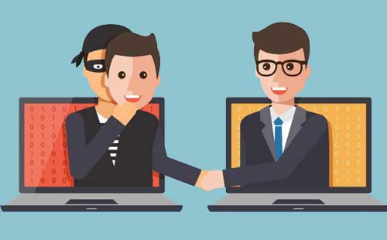

Slide 4
Concepts Used for My WebTicket
50% from both the concepts are responsible for successful user authentication and verification.
Facial Recognition
Keystrokes Dynamics

Slide 5
Facial Recognition
The facial recognition is done using an algorithm that scans the curves, the bulges, the depth in the skin of the user. It considers all these factors to predict the user’s identification.

Slide 6
Keystrokes Dynamics
The 3 most widely used features for keystroke dynamics are:-
Hold time – time between press and release of a key.
Keydown-Keydown time – time between the pressing of consecutive keys.
Keyup-Keydown time – time between the release of one key and the press of next key.

Slide 7
